Slide 1
Computer Networks CS 3001 (BCS-5B) Lecture 3
Danyal Farhat
FAST School of Computing
NUCES Lahore

Slide 2

Chapter 3: roadmap
Transport-layer services
Multiplexing and demultiplexing
Connectionless transport: UDP
Principles of reliable data transfer
Connection-oriented transport: TCP
Principles of congestion control
TCP congestion control

Slide 3
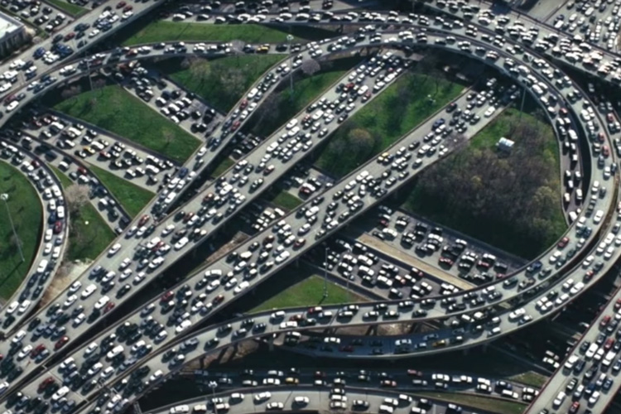


Principles of congestion control
Congestion:
informally: “too many sources sending too much data too fast for network to handle”
manifestations:
long delays (queueing in router buffers)
packet loss (buffer overflow at routers)
different from flow control!
congestion control: too many senders, sending too fast
a top-10 problem!
flow control: one sender too fast for one receiver

Slide 4

Approaches towards congestion control
End-end congestion control:
no explicit feedback from network
congestion inferred from observed loss, delay
ACKs
data
data
ACKs
approach taken by TCP

Slide 5
Approaches towards congestion control
Network-assisted congestion control:
routers provide direct feedback to sending/receiving hosts with flows passing through congested router
may indicate congestion level or explicitly set sending rate
explicit congestion info
ACKs
data
data
ACKs
TCP ECN, ATM, DECbit protocols

Slide 6
Chapter 3: roadmap
Transport-layer services
Multiplexing and demultiplexing
Connectionless transport: UDP
Principles of reliable data transfer
Connection-oriented transport: TCP
Principles of congestion control
TCP congestion control

Slide 7
TCP congestion control: AIMD
approach: senders can increase sending rate until packet loss (congestion) occurs, then decrease sending rate on loss event
Additive Increase
Multiplicative Decrease
increase sending rate by 1 maximum segment size every RTT until loss detected
cut sending rate in half at each loss event
AIMD sawtooth
behavior: probing
for bandwidth
TCP sender Sending rate
time
Notes:
MSS = 512 or 536 bytes
40 [TCP & IP headers] => Not Part of MSS
8 Segments => 9 Segments => 10 Segments => Congestion => 10 / 2 => 5 Segments (TCP Reno)
8 Segments => 9 Segments => 10 Segments => Congestion => 10 - 1 => 9 Segments (TCP Tahoe)

Slide 8
TCP AIMD: more
Multiplicative decrease detail: sending rate is
Cut in half on loss detected by triple duplicate ACK (TCP Reno)
Cut to 1 MSS (maximum segment size) when loss detected by timeout (TCP Tahoe)
Why AIMD?
AIMD – a distributed, asynchronous algorithm – has been shown to:
optimize congested flow rates network wide!
have desirable stability properties

Slide 9
TCP congestion control: details
sender sequence number space
TCP sending behavior:
roughly: send cwnd bytes, wait RTT for ACKS, then send more bytes
cwnd
last byte
ACKed
cwnd
sent, but not-yet ACKed
(“in-flight”)
available but not used
TCP rate
~
bytes/sec
~
RTT
last byte sent
TCP sender limits transmission:
cwnd is dynamically adjusted in response to observed network congestion (implementing TCP congestion control)
<
cwnd
LastByteSent- LastByteAcked

Slide 10
TCP slow start
Host A
Host B
when connection begins, increase rate exponentially until first loss event:
initially cwnd = 1 MSS
double cwnd every RTT
done by incrementing cwnd for every ACK received
one segment
RTT
two segments
four segments
summary: initial rate is slow, but ramps up exponentially fast
time

Slide 11
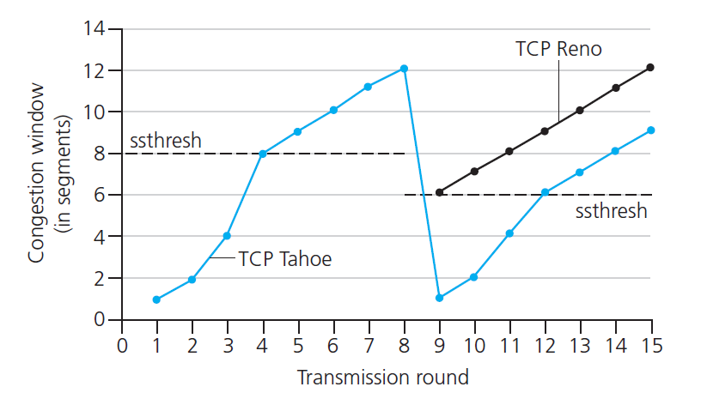

TCP: from slow start to congestion avoidance
Q: when should the exponential increase switch to linear?
A: when cwnd gets to 1/2 of its value before timeout.
X
Implementation:
variable ssthresh
on loss event, ssthresh is set to 1/2 of cwnd just before loss event
* Check out the online interactive exercises for more examples: http://gaia.cs.umass.edu/kurose_ross/interactive/

Slide 12


Summary: TCP congestion control
New
ACK!
New
ACK!
.
duplicate ACK
new ACK
dupACKcount++
new ACK
cwnd = cwnd + MSS (MSS/cwnd)
dupACKcount = 0
transmit new segment(s), as allowed
cwnd = cwnd+MSS
dupACKcount = 0
transmit new segment(s), as allowed
Λ
cwnd = 1 MSS
ssthresh = 64 KB
dupACKcount = 0
cwnd > ssthresh
slow
start
Λ
congestion
avoidance
timeout
ssthresh = cwnd/2
cwnd = 1 MSS
dupACKcount = 0
retransmit missing segment
duplicate ACK
timeout
dupACKcount++
ssthresh = cwnd/2
cwnd = 1 MSS
dupACKcount = 0
retransmit missing segment
timeout
New
ACK!
ssthresh = cwnd/2
cwnd = 1
dupACKcount = 0
retransmit missing segment
New ACK
dupACKcount == 3
cwnd = ssthresh
dupACKcount = 0
dupACKcount == 3
ssthresh= cwnd/2
cwnd = ssthresh + 3
retransmit missing segment
ssthresh= cwnd/2
cwnd = ssthresh + 3
retransmit missing segment
fast
recovery
duplicate ACK
cwnd = cwnd + MSS
transmit new segment(s), as allowed

Slide 13
List of Excluded Topics
Chapter 1 - Introduction
Security
History
Chapter 2 – Application Layer
Peer-to-Peer Applications, Video Streaming, CDN, DASH
GDPR
Socket Programming: Creating Network Applications

Slide 14
List of Excluded Topics (Cont.)
Chapter 3 – Transport Layer
The Causes and the Cost of Congestion (Congestion Scenarios)
Fairness in TCP
TCP CUBIC, Congested Bottleneck link, Delay based TCP CC, ECN,
Evolving of transport layer
QUIC

Slide 15
Chapter 3: summary
principles behind transport layer services:
multiplexing, demultiplexing
reliable data transfer
flow control
congestion control
instantiation, implementation in the Internet
UDP
TCP
Up next:
leaving the network “edge” (application, transport layers)
into the network “core”
two network-layer chapters:
data plane
control plane

Slide 16
Thank You!

